Slide 1



CLEARMASK: Noise-Free and Naturalness-Preserving Protection Against Voice Deepfake Attacks
Yuanda Wang¹, Bocheng Chen¹, Hanqing Guo², Guangjing Wang³, Weikang Ding¹, Qiben Yan¹
Michigan State University¹,
University of Hawaiʻi at Mānoa², University of South Florida³
Notes:
Hello everyone, my name is [your name], and I’m excited to present this work “CLEARMASK: Noise-Free and Naturalness-Preserving Protection Against Voice Deepfake Attacks.” I’m presenting on behalf of the authors, who unfortunately couldn’t attend the conference today. This work is a collaboration between Michigan State University, the University of Hawaii, and the University of South Florida.

Slide 2
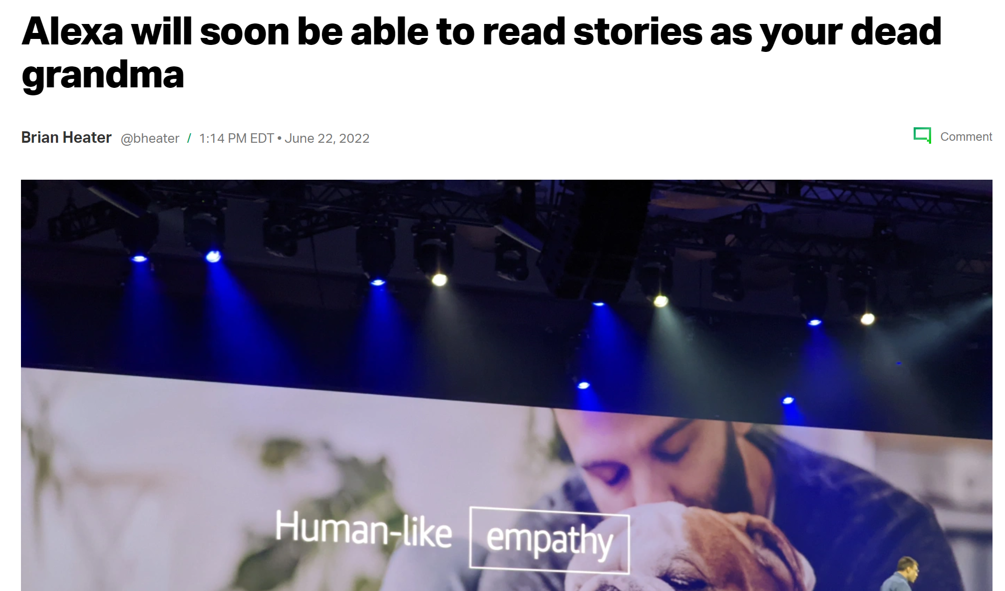

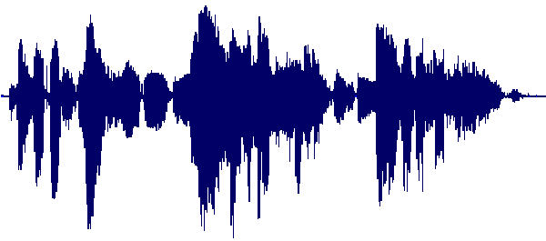

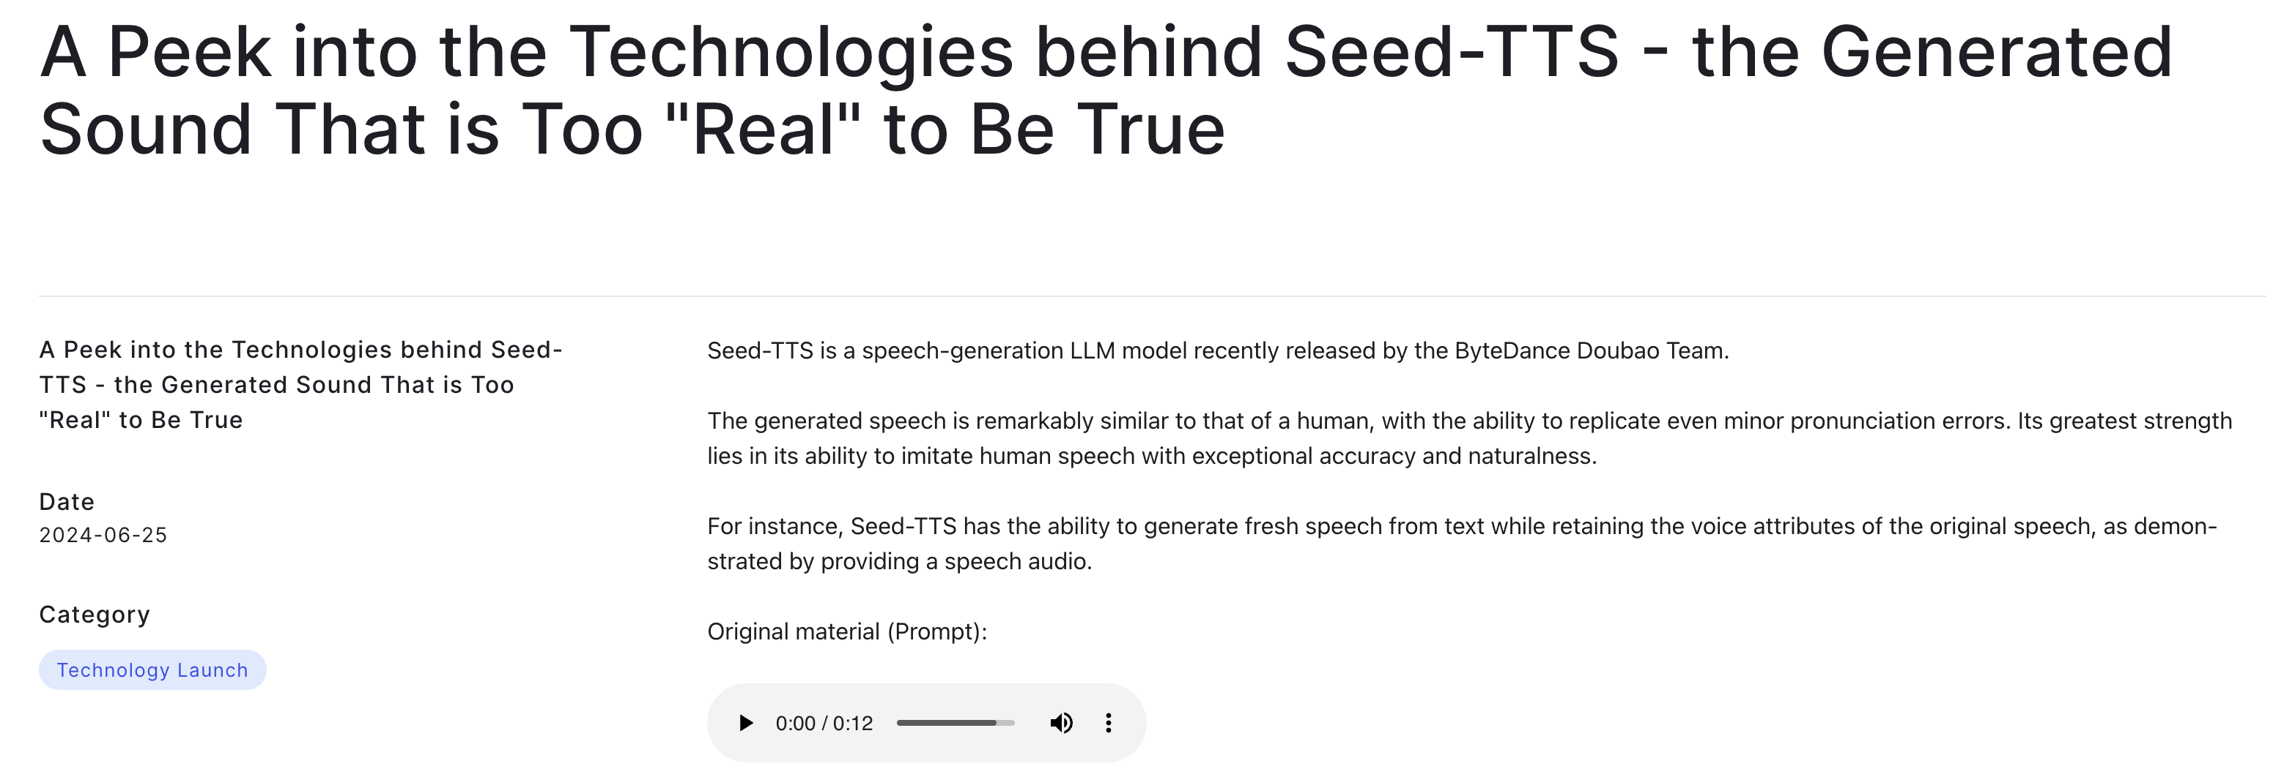
Voice Deepfake Introduction
Somebody’s voice
Voice
Deepfake Synthesis
Jackie Chan’s
voice
Notes:
Voice synthesis technology has rapidly advanced in recent years, allowing the creation of synthetic voices that sound incredibly realistic.
<click>
For example, we can speak some words,
<click>
and make it sound like Jackie Chan. This voice synthesis can be applied in multiple applications, ,
<click>
like Amazon, is developing a product to read stories with real-human voice. ,
<click>
Or some speech LLM, can answer your questions with customized voice.

Slide 3
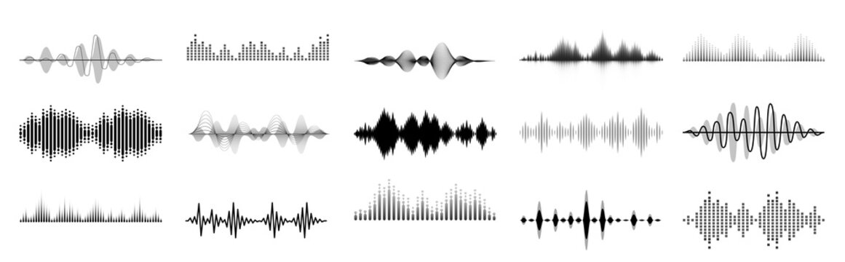
Voice Synthesis Methods
Speaker encoder E_{s}
E_{s}(x)
Synthetic speech
F(p, x)
Input speech x
from target speaker
Decoder
Voice conversion
E_{c}(p)
Content encoder E_{c}
Input speech p
from arbitrary speaker
E_{s}(x)
Synthetic speech
F(t, x)
Speaker encoder E_{s}
Input speech x
from target speaker
Decoder
Text-to-speech
Please don’t clone my voice!
Text-to-speech encoder E_{tts}
E_{tts}(t)
Arbitrary text t
Notes:
There are two types of voice synthesis methods.
<click>
The first one is voice conversion. We have a speech sample from ambient speaker to provide the speech content, and another speech sample from the target speaker, as shown in the blue waveform. Then, the content is encoded by the content encoder Ec and the target speaker’s voice pattern is encoded by the speaker encoder Es. Finally, the decoder will combine the content and voice and output a synthetic speech with the content in speech sample p but sounds like the voice in sample x.
<click>
The other one is text-to-speech. The difference is that text-to-speech does not provide content from a speech but directly from an input text t.

Slide 4
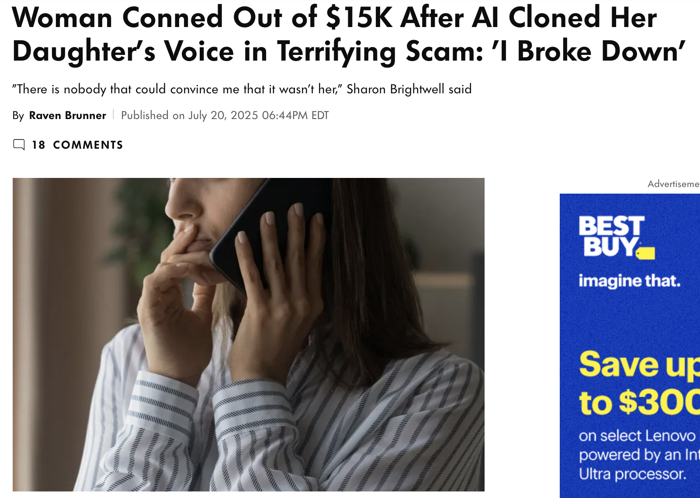
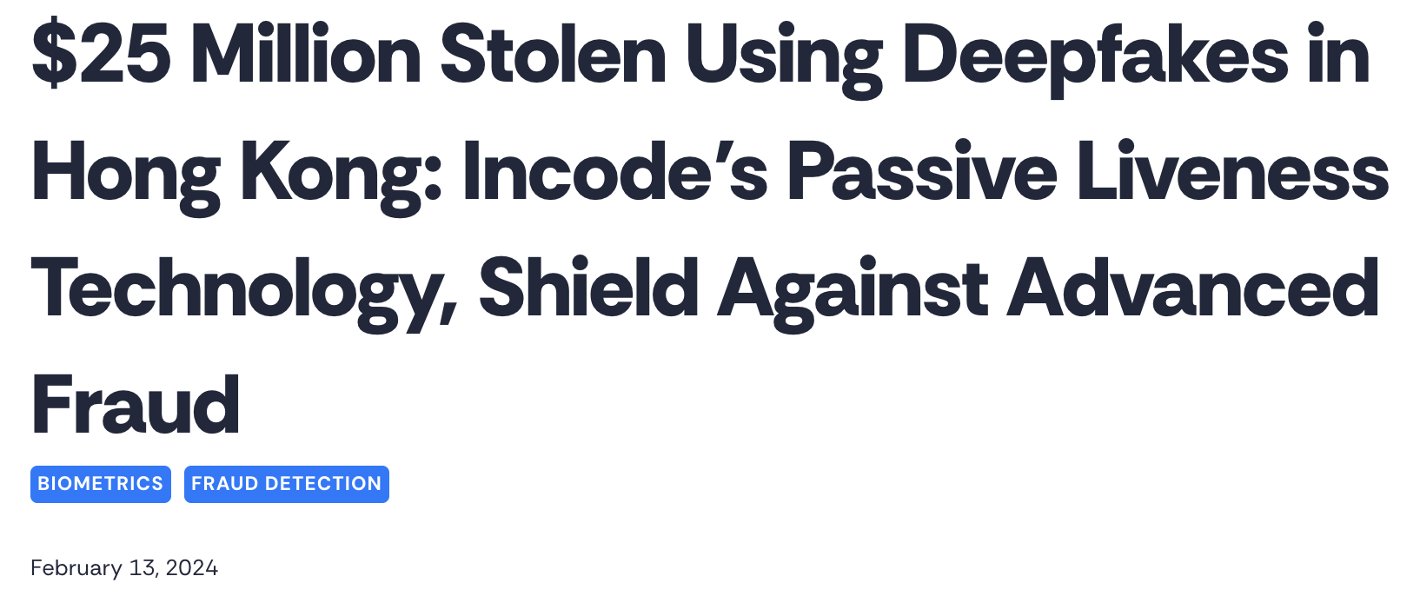
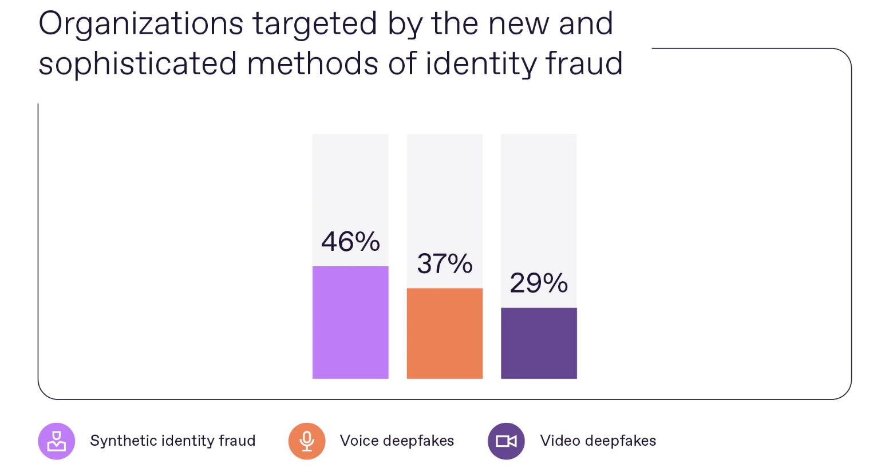
Voice Deepfake Threats
https://people.com/woman-conned-out-of-usd15k-after-ai-cloned-daughters-voice-terrifying-scam-11775622https://www.wsj.com/articles/fraudsters-use-ai-to-mimic-ceos-voice-in-unusual-cybercrime-case-11567157402
https://regulaforensics.com/news/one-third-of-global-businesses-already-hit-by-voice-and-video-deepfake-fraud/
Notes:
Deepfake voices generated through speech synthesis can also be used in malicious scenarios, leading to serious security issues. For example, <click> an attacker could clone a young girl’s voice to trick her parents into paying ransom. <click> In another case, 25 million dollars were stolen in Hong Kong through the cloning of a CEO’s voice. <click> Statistics show that 46% of organizations have experienced identity fraud attacks, and 37% have been targeted by deepfake voice scams.

Slide 5


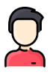



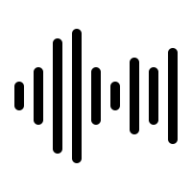







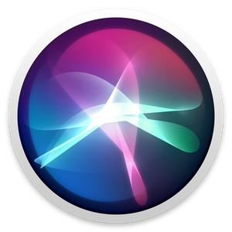
Voice Deepfake Threat Model
Social Media
Real-time communication apps
Voice data can be collected from various sources！
Hello Mom, I am Alice. Can you send me some money?
Of course!
Siri, unlock the door.
The door is unlocked.
Deepfake voices can fool both voice recognition models and human ears！
Notes:
Next, let’s talk about the threat model for voice deepfake attacks. <click> In our model, an attacker first needs a speech sample from the target speaker. This could come from two places: offline data from social media—like a video on YouTube or TikTok— or real-time audio, such as a voice chat or an online meeting. Once they have that sample, they can use it to synthesize the target’s voice. <click> And with that fake voice, they can attack speaker recognition systems—like tricking a voice assistant into executing malicious commands— or fool real people into handing over money.

Slide 6
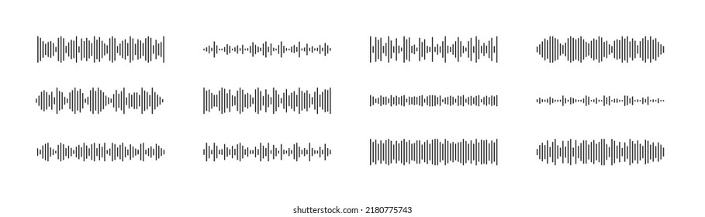
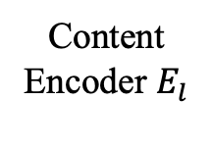
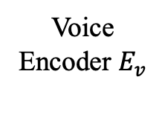
Defense against Voice Deepfake Attacks
“Mom, send me some money!”
Content Encoder $E_{l}$
Adversary
Speech/Text Input
Vocoder
Decoder
Highly-fidelity
Deepfake voice
Voice Encoder $E_{v}$
Victim
Voice Reference Speech
Low-fidelity
Deepfake voice
Audio Mask
Notes:
<click>
Now, let’s talk about how we can defend against potential voice deepfake attacks. <click> As we can see, the content of a deepfake voice is fully controlled by the adversary, and there’s nothing we can change there. <click> But the reference speech samples they use come from the victim. <click> We can upload adversarial samples to disrupt the performance of the voice encoder. <click> Typically, this is done by injecting a noise-based audio mask into the audio samples we share. <click> This can cause the model to produce low-fidelity voices—voices that sound nothing like the intended target.

Slide 7
Defense against Voice Deepfake Attacks -Cont.
Effectiveness
Real-time
Transferability
High-quality
Defenses | Effectiveness | Transferability | High-quality | Real-time
Attack-VC | Medium | Low | Low | Low
SampleMask | Low | Medium | Medium | High
VSMask | High | Low | Low | High
AntiFake | High | High | Medium | Low
Notes:
<click>
To better evaluate the performance of a defense, we measure it across four dimensions.
The first is Effectiveness — the defense must have a high success rate; otherwise, an attacker can still generate high-quality deepfake audio by trying multiple times.
The second is Transferability — the defense should work against different types of speech synthesis models.
The third is High Quality — the protected audio samples must still maintain good audio quality so that normal applications are not affected.
The last is Real-Time — the defense should be able to protect streaming voice data in real time, enabling deployment in instant communication apps.
<click>
However, after evaluating various existing defense methods, we found that none of them satisfy all four dimensions. We still need better solutions.

Slide 8




CLEARMASK Application Scenario
CLEARMASK
Offline Speech
“Siri, unlock the door!”
“The door is unlocked.”
“Access denied.”
Voice Synthesis
“Dad, I am kidnapped!”
“I will give you the money.”
“You are not my son!”
Live Speech
Deepfake Speech
LIVEMASK
With CLEARMASK protection, deepfake voice fail to deceive
speaker verification systems and human ears.
Notes:
<click>
Without any defense in place, an attacker can easily take a short voice sample and synthesize high-quality speech.
<click>
With **ClearMask** protection in place…
<click> <click>
…the attack simply won’t work, because the model gets fooled by the adversarial sample.
<click> <click>
The voice recognition system will refuse to grant control, and people won’t be tricked by the deepfake voice either — it just doesn’t sound like the victim at all.
<click>
So, ClearMask can provide our voices complete protection.

Slide 9

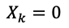
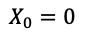
CLEARMASK System Overview
② Audio Style Transfer
③ Reverberation Generation
Style
Encoder
Style
Decoder
Convolution
Original Speech
Style Embedding
Protected Speech
RIR Seed
STFT
ISTFT
Optimization
Raw
Spectrogram
$$X_{0}=0$$
Masked
Spectrogram
Voice
Encoder 1
Voice
Encoder 2
Voice
Encoder n
……
$$X_{k}=0$$
① Spectrogram Masking
Ensemble Encoder
Notes:
<click>
Next, let me walk you through the ClearMask system overview.
ClearMask is built from three different noise-free signal processing methods: spectrogram masking, audio style transfer, and reverberation generation.
This design allows ClearMask to provide strong protection against deepfake attacks, while still keeping the audio quality high.
Next, I’ll dive into each component in detail.

Slide 10
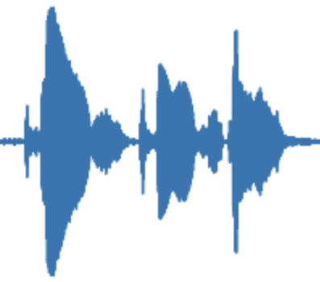
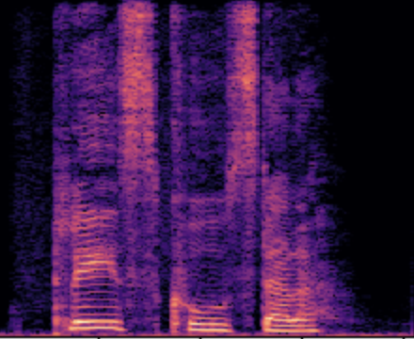
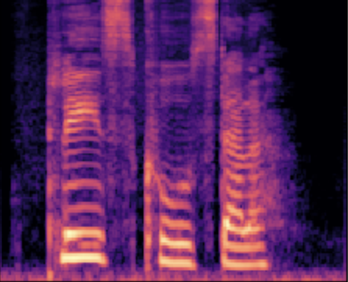
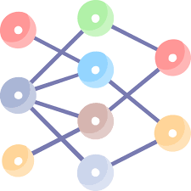
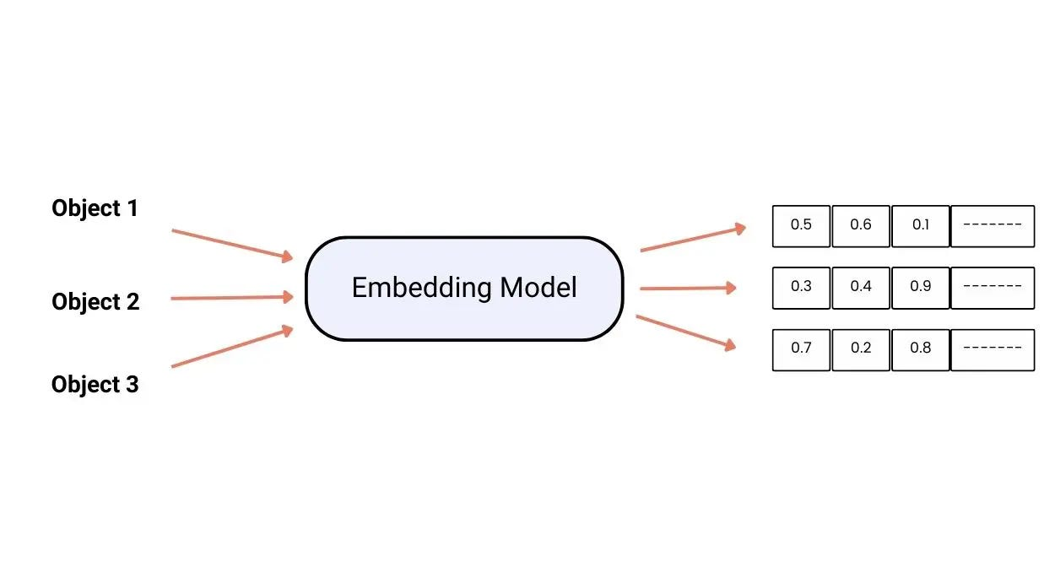
Spectrogram Masking
STFT
Mel-scale
Transferability
High-quality
Embedding Vector
Voice Encoder
Notes:
<click> As we know, in a voice synthesis model, the audio waveform needs to be transformed into a spectrogram through an STFT. <click> Then, it goes through a mel transformation to produce a mel-scale spectrogram,
<click>
which is fed into the voice encoder to output a voice embedding vector. <click> Now, we can insert a filter to remove certain frequency components from the spectrogram. <click> This, in turn, affects the mel spectrogram. <click><click> As a result, the encoder’s output becomes completely different from what it was before filtering. <click> This approach gives us Transferability in our defense, because it doesn’t rely on the gradients of any specific model. Plus, filtering doesn’t add extra noise, so the audio quality stays intact.

Slide 11
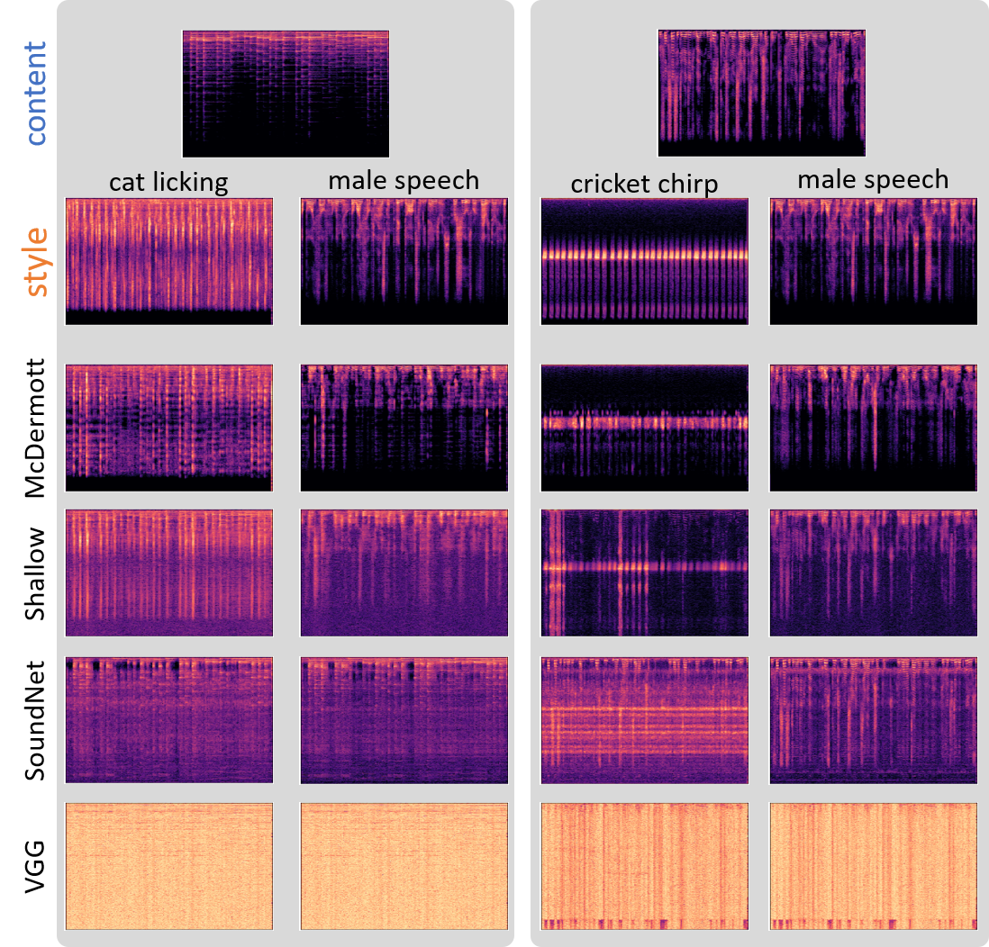
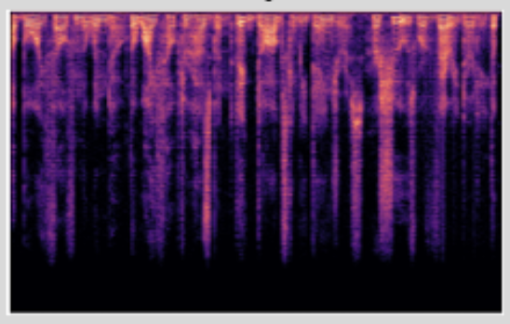
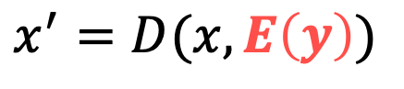
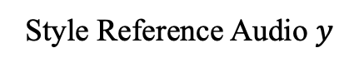
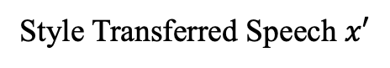
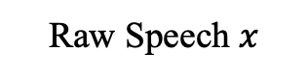
Audio Style Transfer
Style Reference Audio $y$
Raw Speech $x$
Style Transferred Speech $x′$
$$x^{′}=D(x, E\left(y\right))$$
0.3 | 0.1 | 0.25 | …
How to optimize the style embedding vector?
How to guarantee the audio quality after masking?
Notes:
Next is the second step — audio style transfer. <click> We start with a raw speech signal. <click> Then we provide a style reference audio — in this case, a chirp signal. <click> After style transfer, the audio’s texture changes, but its frequency-domain information stays almost the same. <click> Here, we show the mathematical model for audio style transfer, where E(y) is the embedding vector obtained by encoding the style reference audio. <click> We can directly feed this vector into the model to control the style transfer output and protect the speech. <click> But this brings two new challenges: first, how do we optimize this embedding vector? And second, how do we ensure the processed audio still has high quality?

Slide 12
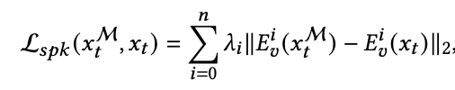
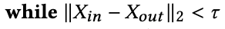
Audio Style Transfer –Cont.
For different deepfake voice synthesis models, they have the same core target.
Voice
Encoder 1
Voice
Encoder 2
Voice
Encoder n
Ensemble Encoder
Transferability
High-quality
Notes:
First, we want to figure out what kind of audio style can better defend against different voice encoder models, so we can disrupt the synthesis of deepfake voices. <click> In fact, different encoder models share one thing in common: they all try to extract invariant voice features from different speech content and project them into a fixed-dimensional space — although the exact dimension may vary from model to model. <click> So, we can combine multiple encoders into an ensemble encoder to improve the transferability of our protection. <click> From the mathematical model, our optimization of the style embedding vector is based on the losses from encoder 0 to encoder n — and we aim to maximize these losses to break the performance of voice synthesis.
<click>
At the same time, to ensure audio quality, we set a threshold during optimization: if the MSE between the style-transferred spectrogram and the original spectrogram exceeds this threshold, we stop the iteration. <click> With this approach, we can further guarantee both transferability and high quality.

Slide 13
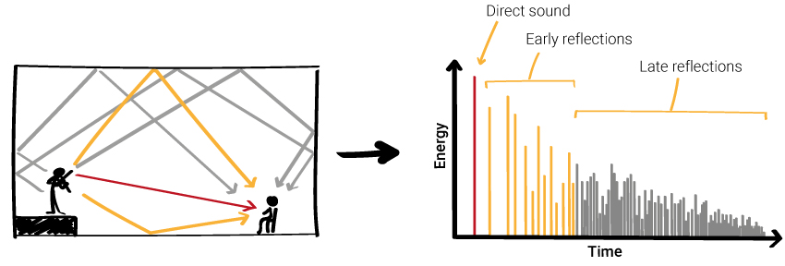
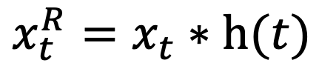
Reverberation Generation
$$x_{t}^{R}=x_{t}∗h(t)$$
Select the RIR that gives the best initial spoofing performance.
Add perturbation to the initial RIR using gradient descent.
The reverberant speech can spoof the voice encoder in deepfake voice generation models.
Notes:
In the final stage, we apply reverberation processing to the transformed audio. <click> As shown in the figure, in an indoor environment, what we hear is actually a mix of direct sound and multiple sound reflections. But because these reflections have very short delays, our ears can’t detect them.
By using this property, we can add very short reverberation effects to the speech signal to further disrupt the performance of voice synthesis models. <click> The process of generating reverberation is shown in this equation: xₜ is the original signal, and by convolving it with hₜ — the RIR signal — we can produce a specific reverberated signal. We then optimize hₜ using the process below. <click> First, we select the RIR signal with the best initial protection performance from an existing dataset of reverberation effects. <click> Then, we further optimize hₜ through gradient descent to improve its effectiveness. <click> Finally, the model with added reverberation can successfully spoof deepfake voice generation systems.

Slide 14
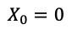
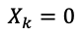
LIVEMASK System Design
① Spectrogram Masking
② Reverberation Generation
STFT
ISTFT
Raw
Spectrogram
$$X_{0}=0$$
Masked
Spectrogram
Convolution
……
$$X_{k}=0$$
Protected Speech
RIR Seed
Original Speech Dataset
Collect a small dataset from a single speaker
Optimize a fixed filter effective across utterances.
Train a reverberation generator to produce adversarial room responses.
Notes:
To make our approach real-time, we designed LiveMask — the real-time mode of ClearMask. <click> The system pipeline is shown here. In this mode, we remove audio style transfer because it has a higher computation delay, while spectrogram masking and reverberation generation can be done quickly.
Unlike ClearMask <click> For a specific speaker, we first collect a small dataset. <click> Then, we optimize a fixed filter for that speaker to perform filtering — this becomes the first stage of the system. <click> We also train a fixed RIR and apply it to all of that speaker’s audio samples, so it achieves the best universal performance.
Because both filtering and convolution operations can be implemented in a programmable hardware solution, the system achieves extremely low-latency signal processing — making it practical for real-time communication apps.

Slide 15
Evaluation Setup
Deepfake Voice Synthesis Models
Surrogate models: AdaIN-VC, AutoVC, SV2TTS;
Open-source models for test: YourTTS, DiffVC, AGAIN-VC;
Commercial models for test: ElevenLabs, Play.ht.
Evaluation Metrics
Similarity Score: the cosine-similarity measured by SpeechBrain;
ETRR: the rejection rate by SpeechBrain ECAPA-TDNN model;
SRR: the rejection rate by Soniox speaker verification API;
Lower similarity score & higher rejection rate represent better performance.
Notes:
Next, we evaluate the performance of ClearMask. <click> First, we tested it against a variety of deepfake voice synthesis models. Three of these models were used as surrogate models for optimizing ClearMask. Then, we tested on three unseen open-source models and two closed-source commercial models. <click> We used three different metrics to measure performance.
First, we used the open-source SpeechBrain model to measure the similarity between the original voice and the synthesized voice.
We also used SpeechBrain and a commercial API -- Soniox to evaluate the rejection rate — the percentage of synthesized voice is denied by a voice recognition system.
Here, lower similarity and higher rejection rate both indicate stronger defense performance.

Slide 16
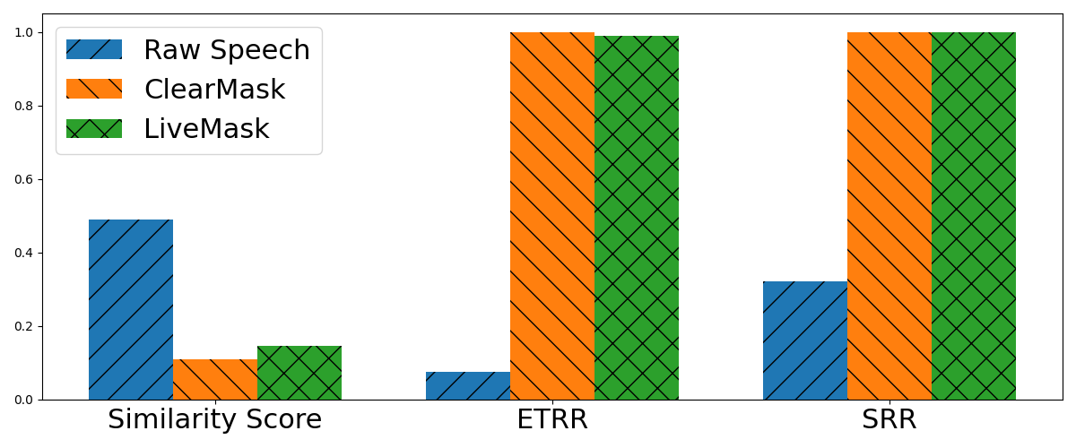
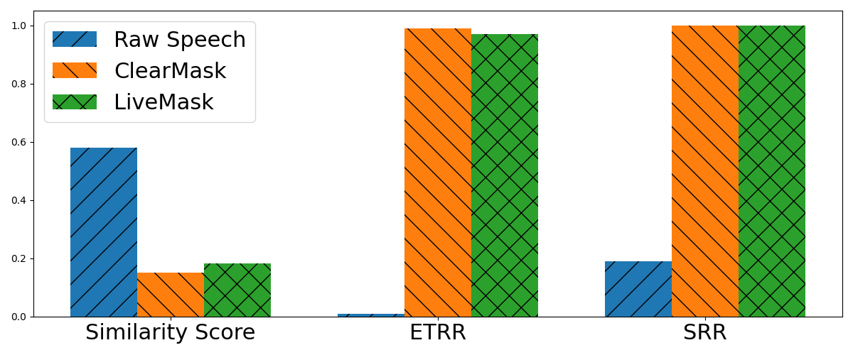
Evaluation – Effectiveness & Transferability
Open-source models
With ClearMask protection, deepfake voice cannot spoof speaker recognition models.
Commercial
models
Notes:
Next, let’s look at performance tests for ClearMask. <click> First, on unseen open-source deepfake voice synthesis models, we measured the average similarity score and rejection rate before and after protection.
We can see that once the original speech is protected by either ClearMask or LiveMask, the similarity between the synthesized voice and the original drops significantly, while the rejection rate rises to nearly 100%.
This shows that our protection is both highly effective and transferable. <click> On commercial voice synthesis APIs — even though their models are larger and more powerful — our protection still works very effectively. <click> So, With ClearMask protection, deepfake voices can no longer fool AI-based speaker recognition systems.

Slide 17
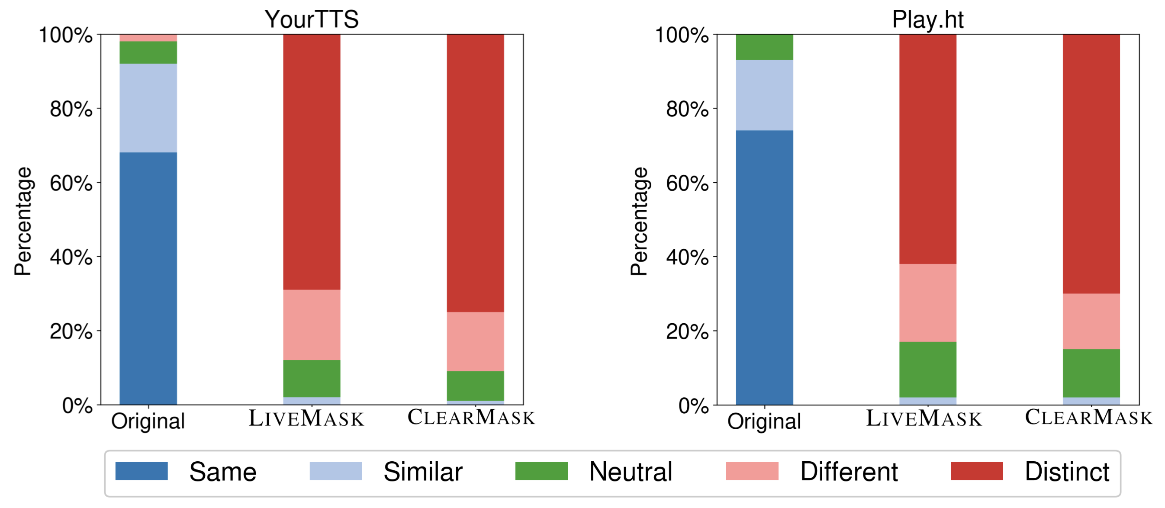
Effectiveness – Human Study
ClearMask can also effectively defend attacks targeting human listeners.
Notes:
Next, we also evaluated ClearMask’s ability to prevent human listeners from being deceived. <click> These two bar charts show human similarity ratings before and after protection, on both open-source and commercial voice synthesis models.
Here, blue means “highly similar,” and red means “completely different.”
We can see that after protection, human ratings shifted from mostly “highly similar” to mostly “completely different.” <click> This means ClearMask can also effectively prevent human listeners from being tricked by deepfake voices.

Slide 18
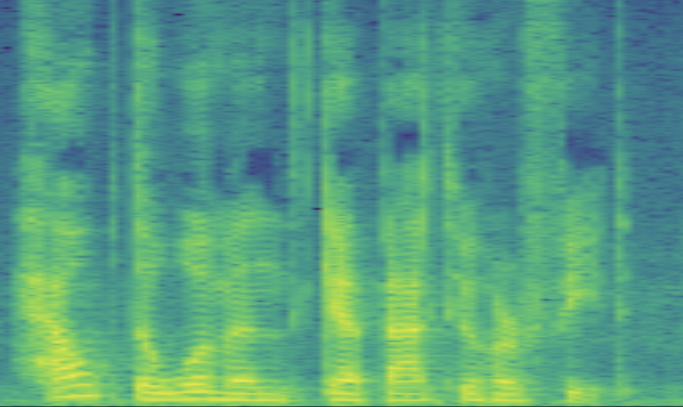
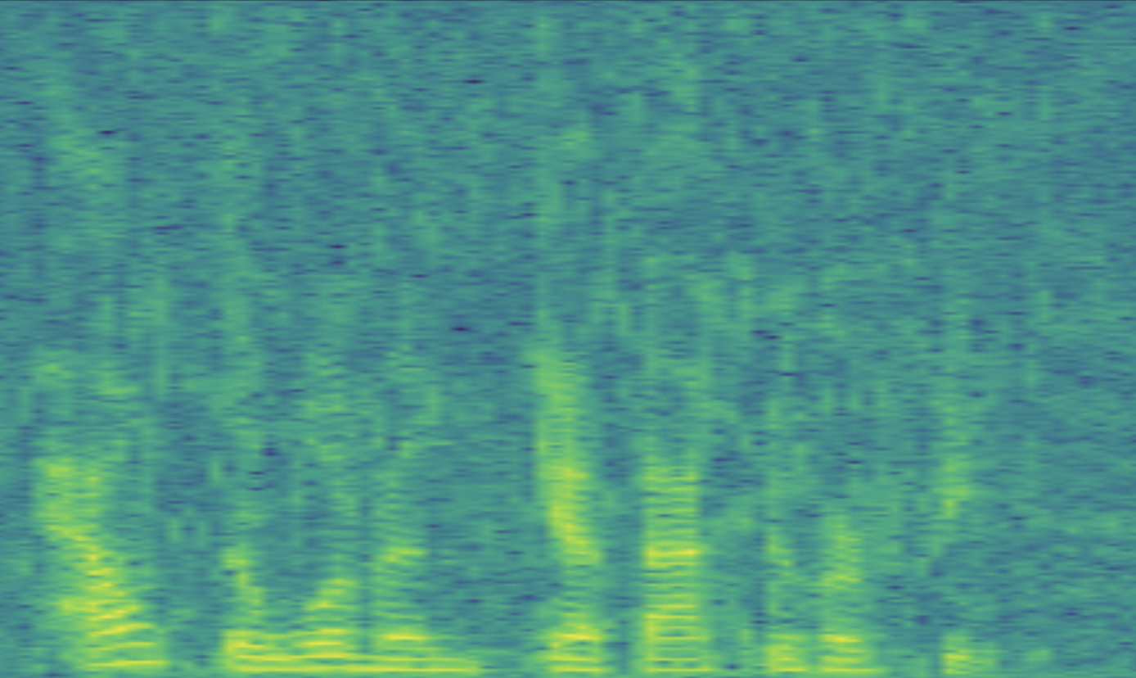
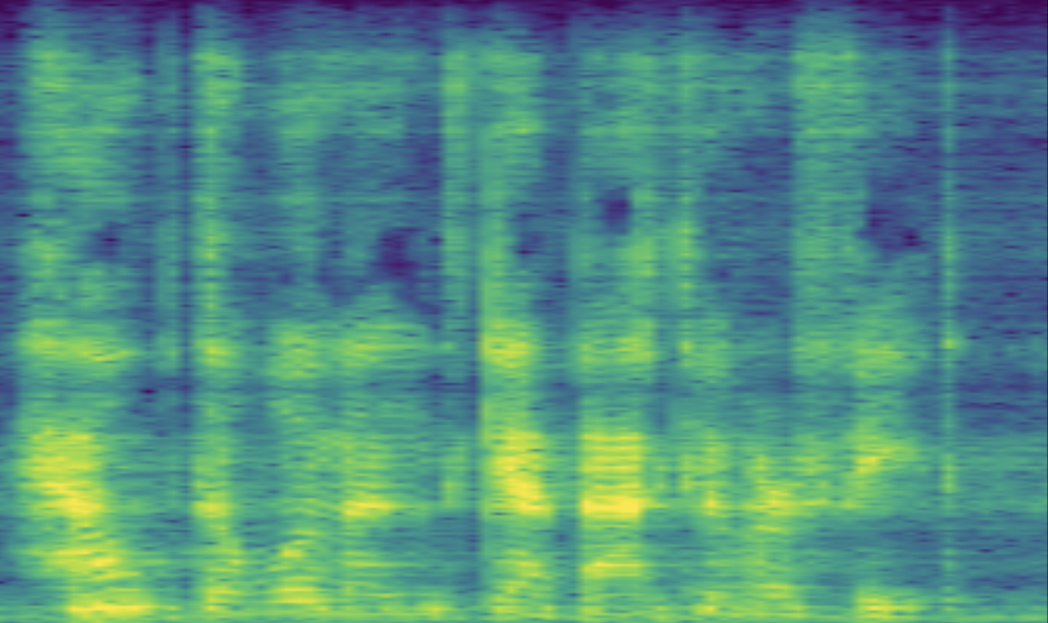
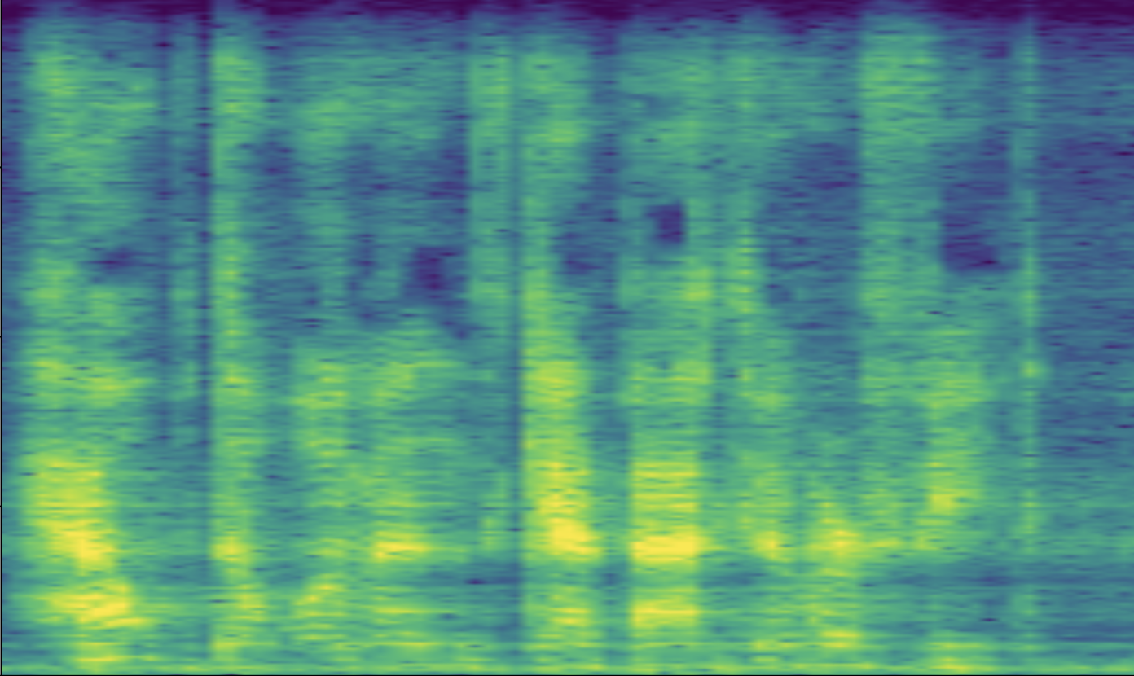
Evaluation– High-quality
ClearMask vs AntiFake
Noisy and lose high-frequency features.
Raw Speech
AntiFake
Maintain high audio quality.
ClearMask
LiveMask
Notes:
After evaluating effectiveness and transferability, we also compare the audio quality of ClearMask with other protection methods.
From the earlier comparison, we saw that AntiFake also achieves strong protection performance. <click> However, if we look at the spectrogram of the original audio versus the audio protected by AntiFake… <click> …we can see that AntiFake introduces a large amount of background noise, making the audio sound noisy and covering most of the high-frequency signals. <click> In contrast, speech processed by ClearMask and LiveMask still shows clear voice features. <click> This demonstrates that our protection can maintain high audio quality.

Slide 19
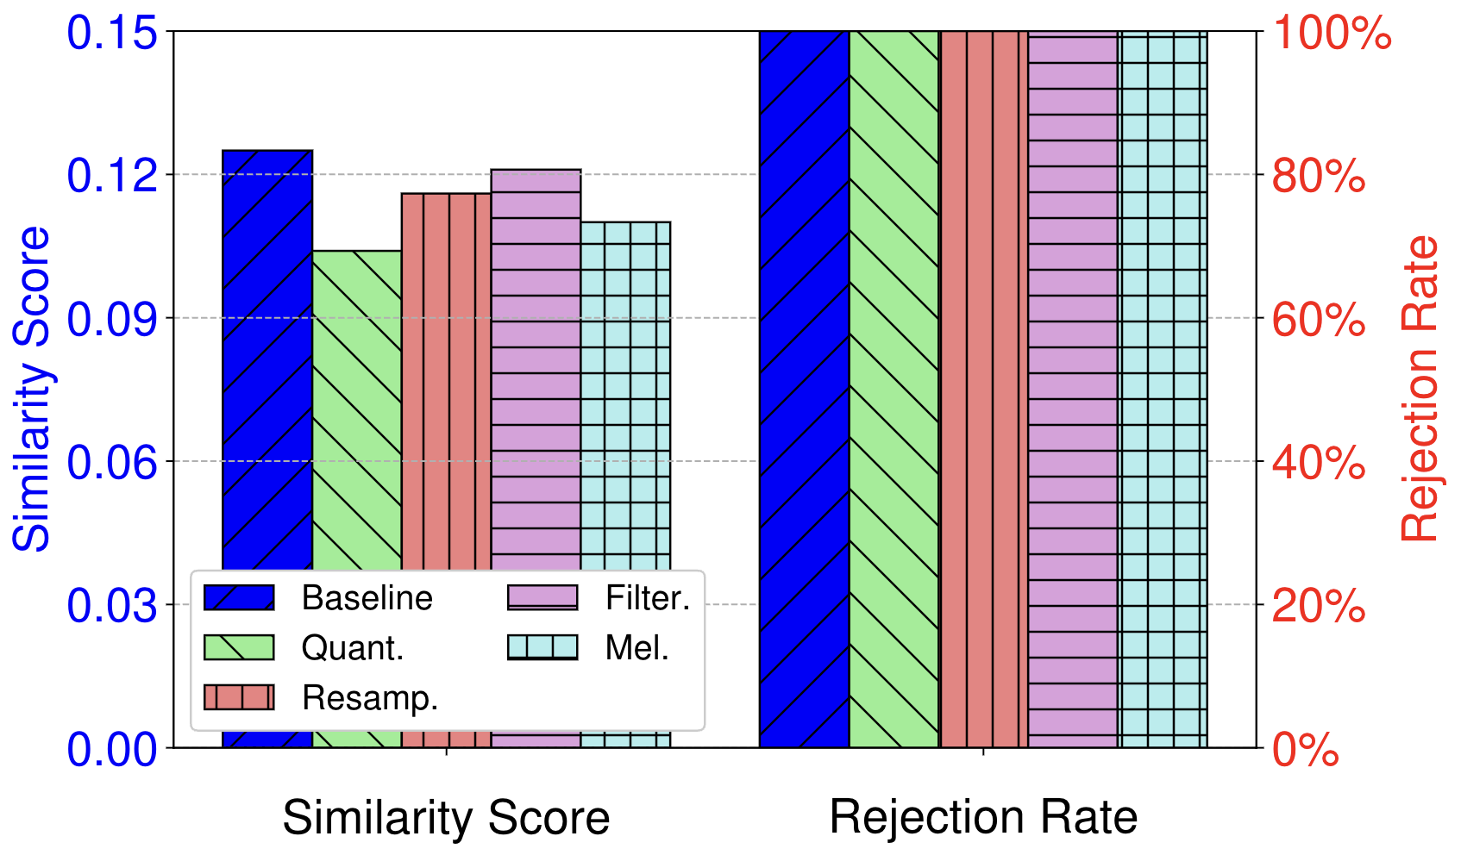
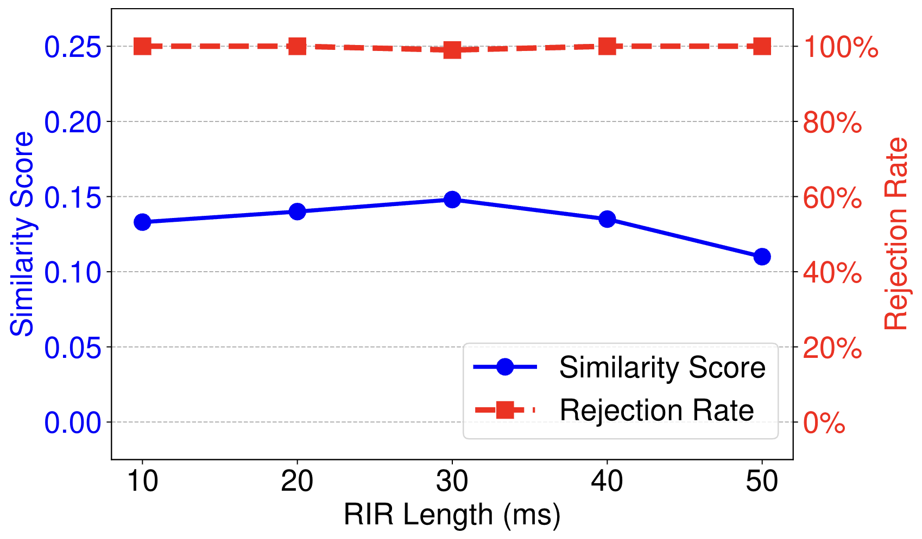
Evaluation - Robustness
ClearMask is robust for adaptive attackers using signal processing or denoising methods.
Notes:
Finally, we also test the robustness of ClearMask against different adaptive attackers. <click> First, we tried different signal transformation methods from WaveGuard to see if they could remove our protection.
But as we can see, after these transformations, the similarity of the new synthesized speech was even lower than the baseline.
This is because filtering, audio style transfer, and similar methods cannot be reversed through simple signal processing, and the signal loss introduced during transformation further reduces the performance of the synthesis model. <click> We also tested whether an attacker could remove our protection by dereverberation.
However, since we specifically optimized our RIR, it is very difficult for the attacker to perfectly recover a clean, non-reverberated signal.
<click>
So, ClearMask can maintain strong robustness even when facing different adaptive attackers.

Slide 20
Conclusion
We propose ClearMask, a noise-free defense mechanism against voice deepfake attacks.
We introduce LiveMask, a real-time mode of ClearMask, to protect streaming audio signals.
We comprehensively evaluate the protection performance of ClearMask on multiple voice synthesis models including commercial APIs. The results demonstrate that ClearMask achieves effective, transferable, high-quality, and real-time protection in various scenarios.
Notes:
Here is the conclusion:
<click>
We…
<click>
We…
<click>
We…

Slide 21

Notes:
Thank you for listening. I am glad to answer your questions.

